Slide 1
Cryptography and the RSA Algorithm
Chris Campbell

Slide 2
Introduction
As the digital age continues to evolve and revolutionize society, security is of the utmost importance. It is paramount that the conceptual methods of security utilized in the real world are adopted into our digital space.
This process is largely done through cryptography.
Cryptography is derived from the Greek word ‘Krypos’ meaning hidden.
Cryptography literally translates to ‘hidden writing’
Cryptography can be used to obscure any form of digital communication including text, images, video, and audio.
This is accomplished through transforming data into an unreadable format know as ciphertext. This can only be decrypted back into a readable format known as plaintext using some form of decryption method.
The process of encryption and decryption vary between algorithms.

Slide 3
Asymmetric Algorithms
Asymmetric encryption uses private/public key pair system.
The public key can be openly shared since it is only used for the sake of encrypting data. It has no power for decryption.
The private key is generally not shared. The private key is used to decrypt the data which was formerly encrypted by the public key.
Asymmetric encryption uses complex mathematical computation models.
This makes asymmetric encryption less efficient than other forms of cryptography like symmetric encryption.
However, this also makes asymmetric encryption far more secure than other cryptographic algorithms like symmetric encryption.

Slide 4
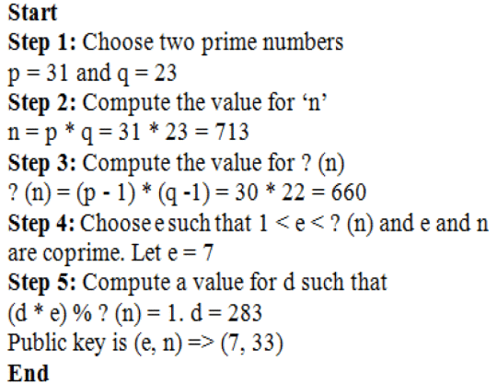
RSA Algorithm
the RSA encryption method was developed by three professors at MIT. The name RSA comes from the last names of these professors; Ron Rivest, Adi Shamir, and Len Adleman.
RSA is a form asymmetric encryption. It uses properties of prime numbers and modular arithmetic to develop a private and public key pair.
To begin, two initial prime numbers need to be selected represented as ‘p’ and ‘q’. Additionally, a value for ‘e’ must be selected. The value for ‘e’ must be a prime number and needs to be greater than 1.
As shown, the public key is represented by ‘(e,n)’ which equates above to ‘(7, 33)’. The private key is represented by ‘d’ which equates to ‘283’.

Slide 5
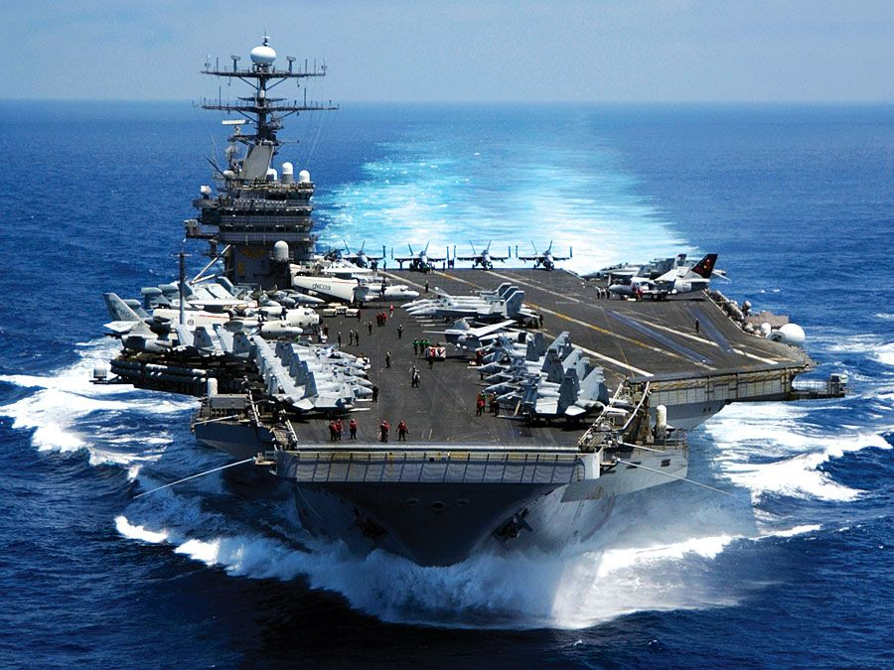

Developing an RSA algorithm for maritime coordinate encryption
Particularly as it pertains to military maritime activity, it is incredibly important to keep the locations of our country’s naval vessels confidential.
Having spent six years in the Navy station onboard the aircraft carrier USS Dwight D. Eisenhower, I am keenly aware of the importance of keeping our location secret.
While ensuring the confidentiality of an aircraft carrier’s location could be a challenge at times, it’s not the purpose of an aircraft carrier to be particularly stealthy with planes constantly flying back and forth from it.
However, the location of our country’s submarines are top-secret. These vessels are located at tactical locations around the world with the ability to fire missiles, including nuclear warheads, at any time from undisclosed locations.
The coordinates of these ships must be transmitted between one another and back to Naval headquarter. One way this could be accomplished is using an asymmetric algorithm, particularly RSA.

Slide 6
coordinates of marine vessel explained
Generally, the location of marine vessels is sent via Automatic Identification Systems (AIS) which are transmitted over radio waves. Computer models interpret these transmission to associate different types of marine vessels and their coordinates.
Kurt Schwehr wrote a program that interprets these radio signals as plaintext.
These plaintext message share information such as a ships longitude, latitude, Marine Mobile Service Identities (MMSI), date and time, heading, etc.
Albeit military vessels only broadcast to all other ships via AIS when transiting through high traffic areas, they still need to always return their coordinates to other naval ships and headquarters. Especially when in the theater of combat.
This is generally done through satellite communications.
While satellite communications and AIS are different, the coordinates they share are similar.

Slide 7
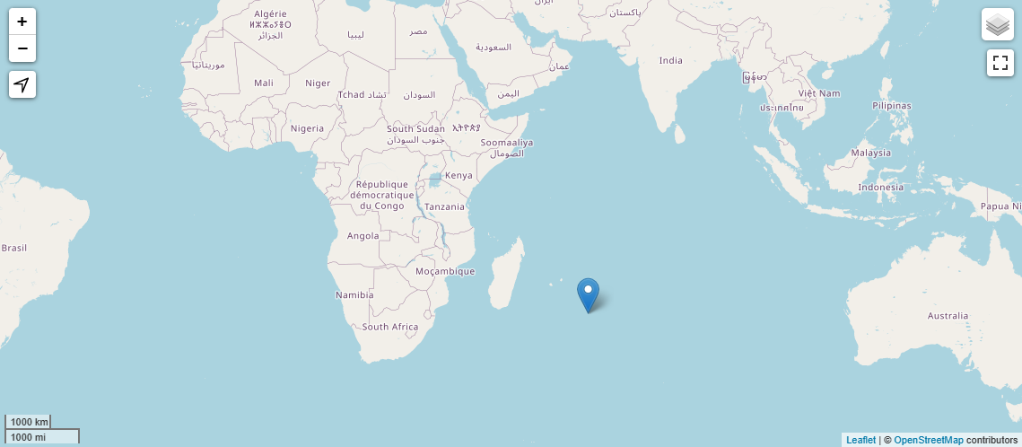
Setting up the scenario
To begin, we will be setting up a plaintext message of a marine vessel’s coordinates known as VALIMATO callsign CUFN.
Technically this is a fishing vessel. However, military ships would pass coordinates in the same way.
The ship is operating near Madagascar in the Indian Ocean with the following coordinates.
mmsi: 263576000
timestamp: 2016-10-07 00:07:29 UTC
longitude: 62.7572784424
latitude: -26.3910827637
speed: 1.5
course: 296.0
heading: 354
sync_state: 3
maneuver: 0
class: AIS
The intention of the script we are developing will be to generate a public and private key pair via RSA. This key pair must have the ability to encrypt this plaintext and decrypt the subsequent ciphertext back into the original plaintext coordinates.

Slide 8
Development process of the script
The script developed has been written in python with the help of ChatGPT.
To begin, I prompted ChatGPT to develop a python script with the ability to generate public/private key pair using the RSA algorithm. From here, I asked ChatGPT to include functions for encrypting and decrypting a plaintext file using the generated keys.
The process of troubleshooting started from here. While ChatGPT is truly incredible resource, it is not without its problems.
One issue I ran into with ChatGPT was when the code was throwing an error and it kept repeating the same line of code as a fix which was the same as the faulty line of code. It was convinced that it was correct, and it was not.
However, I then prompted ChatGPT what the potential fixes for the error could be and it returned me a list of potential fixes. From that list I was able to clear the error code.
Overall, this process took a few hours of troubleshooting to get a functioning working properly. Without the help of ChatGPT this script would have likely taken me over a week to develop by myself.
This is primarily because this script relies heavily on the ‘Cryptography’ library and its associated modules to develop this code. I have never used this module before and it would have taken a lot of time, energy, and effort just in researching.

Slide 9
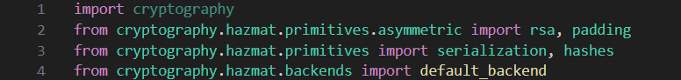
Breakdown of the script Step 1. Importing Modules
Moving forward, I will show the script in pieces with an explanation of what each part of the code is doing. Many of the piece of code which rely on the ‘cryptography’ library I will be explaining with the help of ChatGPT.
Below is the first 4 lines of code sharing all of the modules imported:
We begin with import cryptography which imports the entire cryptography library.
Next from cryptography.hazmat.primitives.asymmetric import rsa, padding which provides the functionality of working with the RSA encryption padding scheme.
from cryptography.hazmat.primitives import serialization, hashes provides the functionality for serializing cryptographic objects and working with cryptographic hashes.
from cryptography.hazmat.backends import default_backend This module provides the cryptographic backend implementation which is used by the ‘cryptography’ library operations.

Slide 10
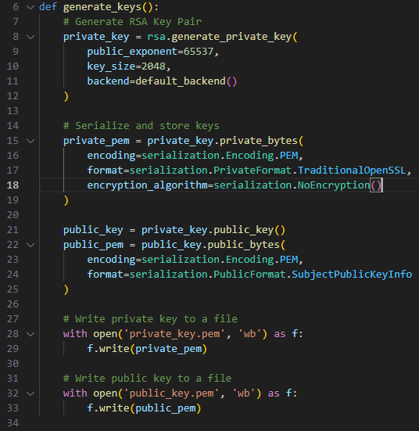
Step 2. Generating the RSA Keys
Moving on, the sections of code will be broken down by comment section
# Generate RSA Key Pair
This portion of the code generates the RSA private key with a public exponent of 65537 and a key size of 2048 bits.
A public exponent of 65537 and at least 2048 bits is a common choice and should always be used unless there is a specified reason to do otherwise.
# Serialize and store keys
This portion of code serializes the public and private keys to be saved. The process of serialization transforms the keys from script form to a byte stream which can be saved. Additionally, it specifies the proper encoding format .
# Write private key to a file and # Write public key to a file
These two comments write private and public keys respectively to an output file to be used later in this script.

Slide 11
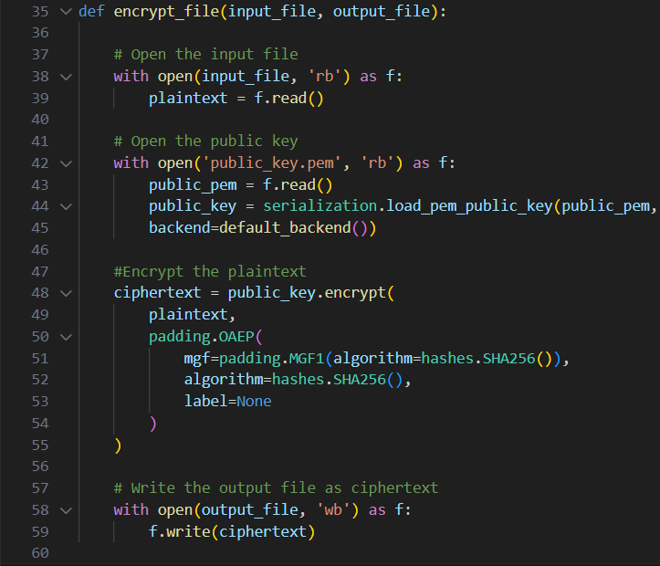
Step 3. Encrypting the plaintext
# Open the input file
This section of code opens the input file, which in our case will be the plaintext of our ship’s coordinates.
# Open the public key
This section will open the public key created earlier. The serialization module used here is used to deserialize the key for use in the program.
# Encrypt the plaintext
This encrypts the plaintext using the public key. The encryption is used with Optimal Asymmetric Encryption Padding (OAEP), which is a padding scheme used in RSA encryption to add probabilistic encryption.
# Write the output file as ciphertext
This section will write the newly created ciphertext to a text file.

Slide 12
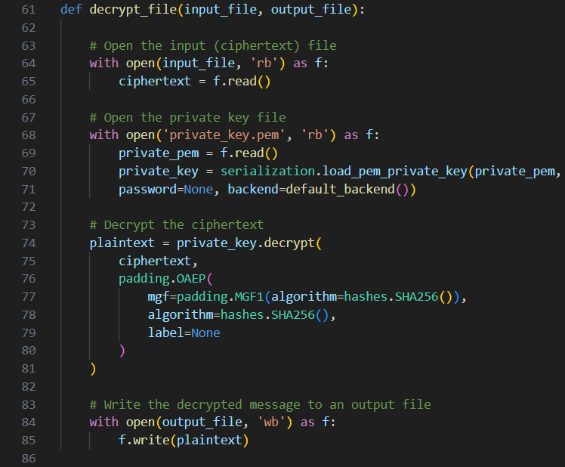
Step 4. decrypting the plaintext
# Open the input (ciphertext) file
Here the input ciphertext file is read into the function and assigned to the variable ciphertext.
# Open the private key file
This section will open the private key created earlier. The serialization module used here is used to deserialize the key for use in the program.
# Decrypt the ciphertext
This decrypts the ciphertext using the private key. The encryption is used with Optimal Asymmetric Encryption Padding (OAEP), which is a padding scheme used in RSA encryption to add probabilistic encryption.
# Write the decrypted message to an output file
This section will write the decrypted ciphertext as plaintext to a file.

Slide 13
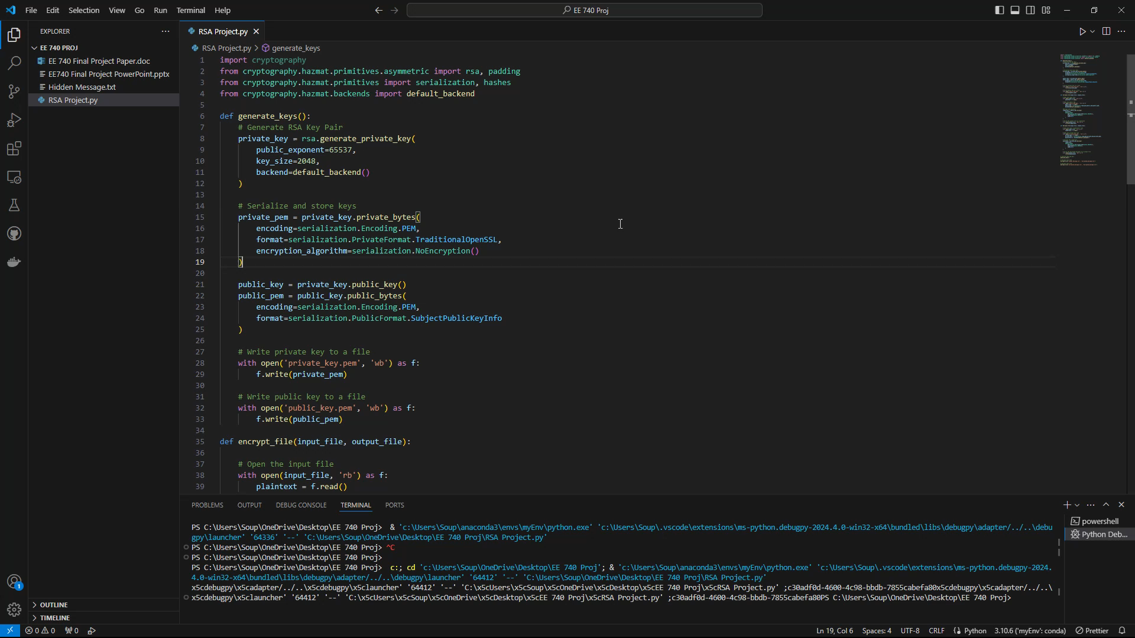
Step. 5 Call the functions and run the program

Slide 14
Conclusion
In conclusion, cryptography is an incredibly important asset in the modern digital age
The ability to obfuscate digital data we do not want others to have access to is paramount in ensuring privacy and safety online.
This project has been an example showcasing the ability to interface with OpenAI’s ChatGPT LLM to aid in the development of scripts for writing programs.
We took the concept of RSA asymmetric encryption and incorporated it into a python script to create a public and private key pair which we could then use for the sake of encryption and decryption of data.
As expressed in the example, ensuring the confidentiality of our naval vessels is of the utmost importance to our country. This project showcases one way in which plaintext coordinates could be obfuscated to remove the threat of enemies intercepting these coordinates.

Slide 15
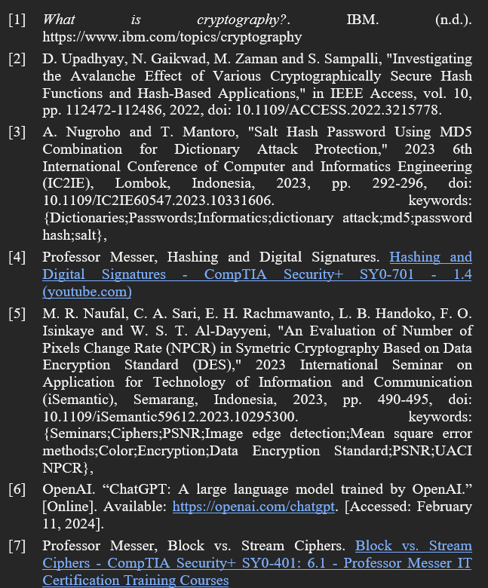
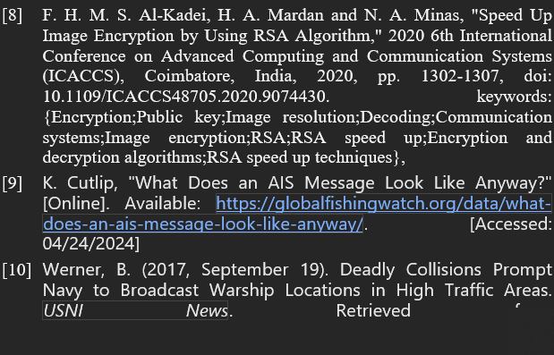
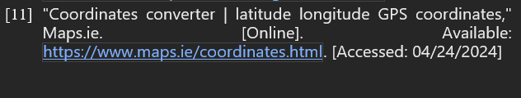
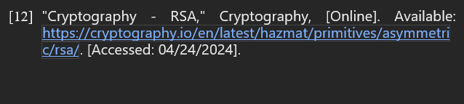
Referneces

